Slide 1
Konsum in der digitalen Zukunft
Prof. Dr. Elgar Fleisch
ETH Zürich & University of St. Gallen (HSG)
WU Competence Day
Wien, am 17. November 2011

Slide 2
Persuasive Computing

Slide 3
The power of defaults
opt out form
% Organ donor
opt in from
Source: Prof. A. Herrmann

Slide 4
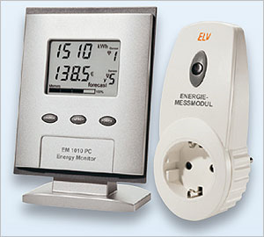
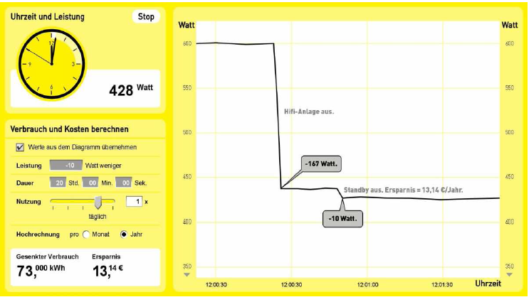
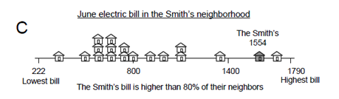
Status Quo: “Engineers engineer for male engineers with academic background”
http://www.echtshop.de/
yello
Assumption: Mankind is rational
No analogies, no comparisons, no cool plots

Slide 5
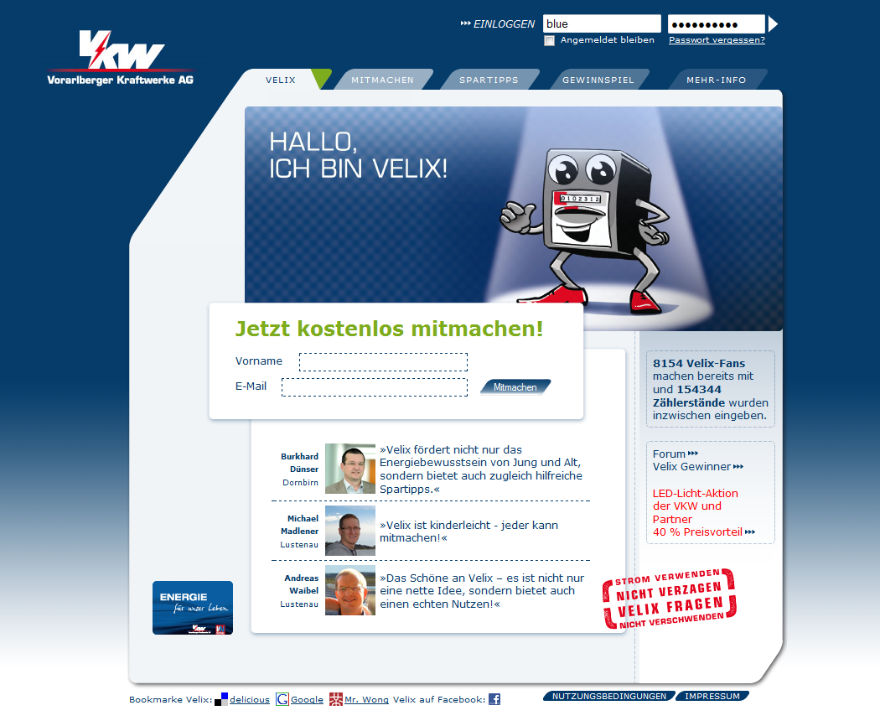
Velix – the behavioral economy-effect-loaded portal to help consumers to save energy

Slide 6
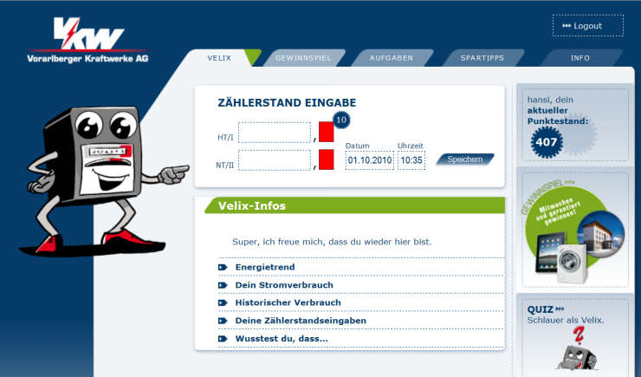
Velix – the behavioral economy-effect-loaded portal to help consumers to save energy
Sources: Bits to Energy Lab & VKW
Notes:
Velix is
... a portal
… power saving game
… research platform to test the “hidden forces that shape our energy decisions”
How felix works
Enter data (electricity meter, size of house, family, heating technology)
Get points, win presents
… and …

Slide 7
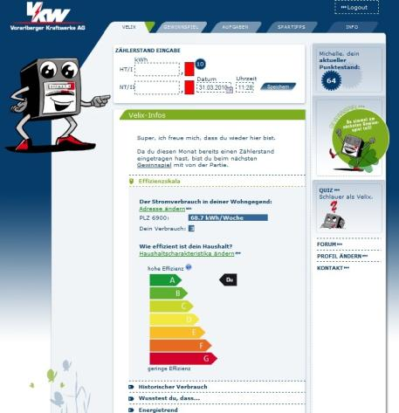
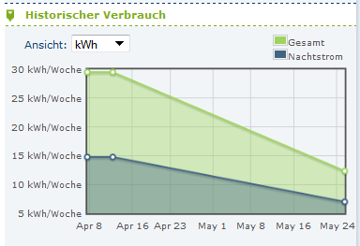
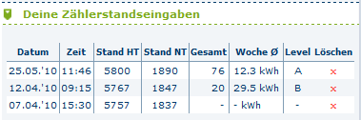
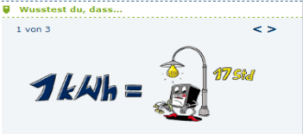
Implementing and deploying a best practice online portal - Velix
All sources: www.vkw.at/velix
Notes:
Learn something
… absolute consumption last week
… comparison with last year, your neighbors, your village, the county
… evaluation how good you are, given the size of your house?
… consulting and energy saving tips
… basic knowhow

Slide 8
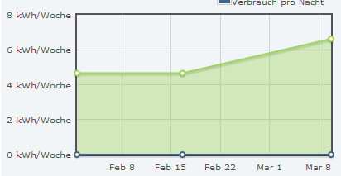
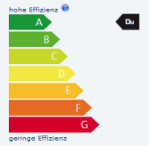
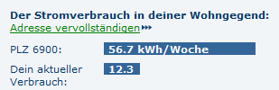

Feedback on energy consumption can be given in various forms – which one is best?
Feedback
Historic feedback
Your last weeks
electricity consumption:
56 kWh
Descriptive feedback
Injunctive feedback
You
Neighbours
Notes:
Research project of ETH Zurich & HSG
Of course, being researchers, we did not show everybody with same input the same information, we made experiments
We separated the users into different groups and showed different feedback types – and measured the impact in terms of energy consumption
Some we showed Feedback in kWh, historic feedback, descriptive feedback, and injunctive feedback
What did we learn:
… the injunctive feedback is superior to all the others in most cases – people want to be assessed
… Descriptive feedback is no good when you are better than average – drives you towards average
... Local comparison works best, however, not the comparison with your direct neighbor you know very well

Slide 9
The choice of the reference group has a great impact on the results!
Änderung Energieverbrauch in %

Slide 10
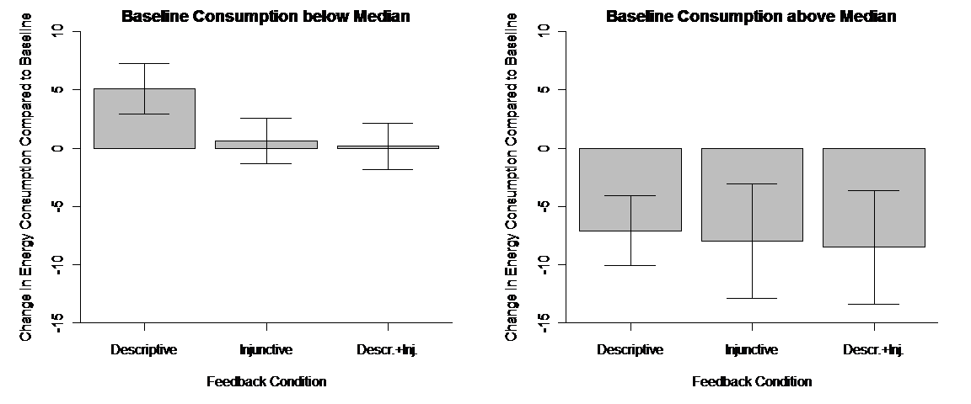
Social norms work – in both directions!

Slide 11
First Velix results
In 12 Monaten:
>10‘000 Registrierungen
>235‘000 Zählerstände
~500 Besuche pro Tag
~6 Minuten Ø Besuchszeit
~50 Stunden Kundeninteraktion pro Tag, sieben Tage die Woche
>2200 haben versucht, ihre Zähler zum Stillstand zu bringen
Nutzer sparen gerne Energie:
>4% Stromeinsparung je Nutzer
>1‘000 Empfehlungen an andere Kunden gesendet
>5‘000 Erinnerungen gesetzt
>420‘000 Quizfragen beantwortet
Positive Resonanz:
Sehr gute Presse
Nutzer schlagen neue Features vor
Keine Abschwächung der Kampagne über die Zeit

Slide 12
Persuasive Computing and the Internet of Things

Slide 13
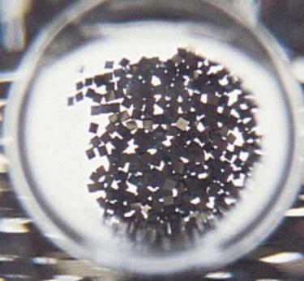

Low cost minicomputers ...

Slide 14
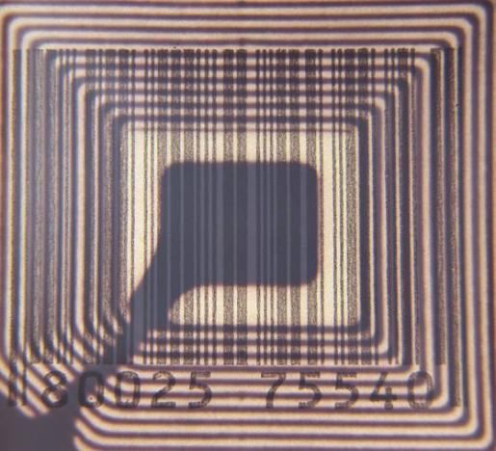
... with mobile communication capabilities ...

Slide 15
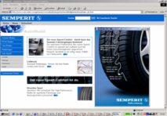
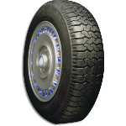
... help linking real world objects automatically with the Internet
Virtual world
Real
world

Slide 16
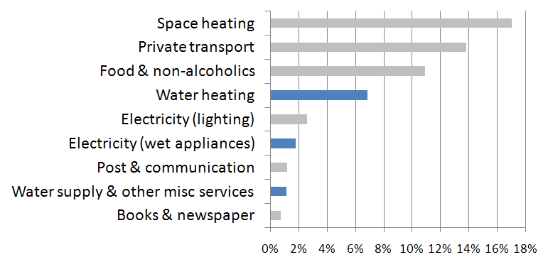
The carbon footprint of warm water is larger than expected (10% of CO2 emissions)
Source: UK Carbon Attribution Model, Centre for Environmental Strategy, University of Surrey, 2005
Notes:
Saving drinking water
Reducing the carbon footprint of hot water that counts for 10% of the CO2 emissions!

Slide 17
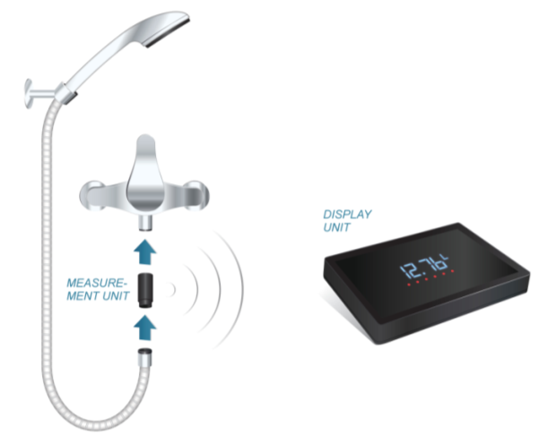
With Amphiro, your shower becomes smart.
Source: Amphiro
Notes:
Little power station
- turbine the generates power
- that runs a microcontroller
- that measures flow and temperature
- and sends messages to the bathroom
Join with shower head or faucet
Shower and learn
Can buy it 2011 / 2012

Slide 18


The story of Thorsten and Stephan
Thorsten
Stephan
70 liters
160 liters
50 liters
50-60 liters
Notes:
What changed? How much?
Thorsten: head of all this research 70 – 50
Stephan: Mobile phone research at my lab: 160 liters – even alone
Now: changed shower head and habit: 50-60 liters

Slide 19
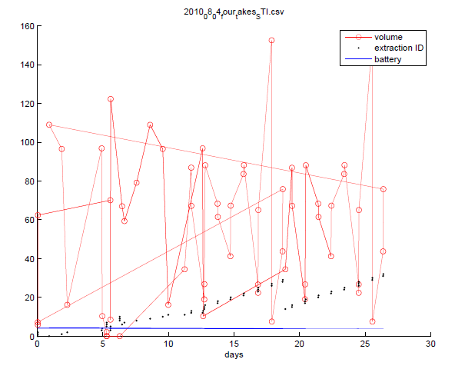
When you start measure and display behavior, funny things happen
Notes:
Reduction by 8-10%
Experiment
- Counting up
- counting down
- with / without decimal places

Slide 20
First results are promising
12.9% household average over all
  210 kWh per household & year
  6400 l per household & year
18.6% household average of above average user
Total water consumption reduced by 22.2% (baseline vs. display)
Effects persistent over time

Slide 21
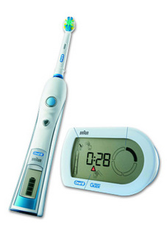
Computers help cleaning teeth
Notes:
Handle / Shaft + Brush + Display
Wireless communication and constant checking
Count up seconds, show which quarter to clean (up / down / left / right), pressure warning
Shows smiley
Can’t stop my children from cleaning there teeth
“Dad, no, now up there”
A computer does my education

Slide 22
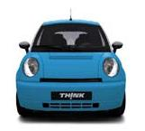
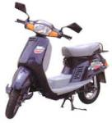
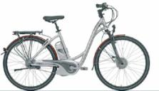
Why don‘t they talk to us?

Slide 23
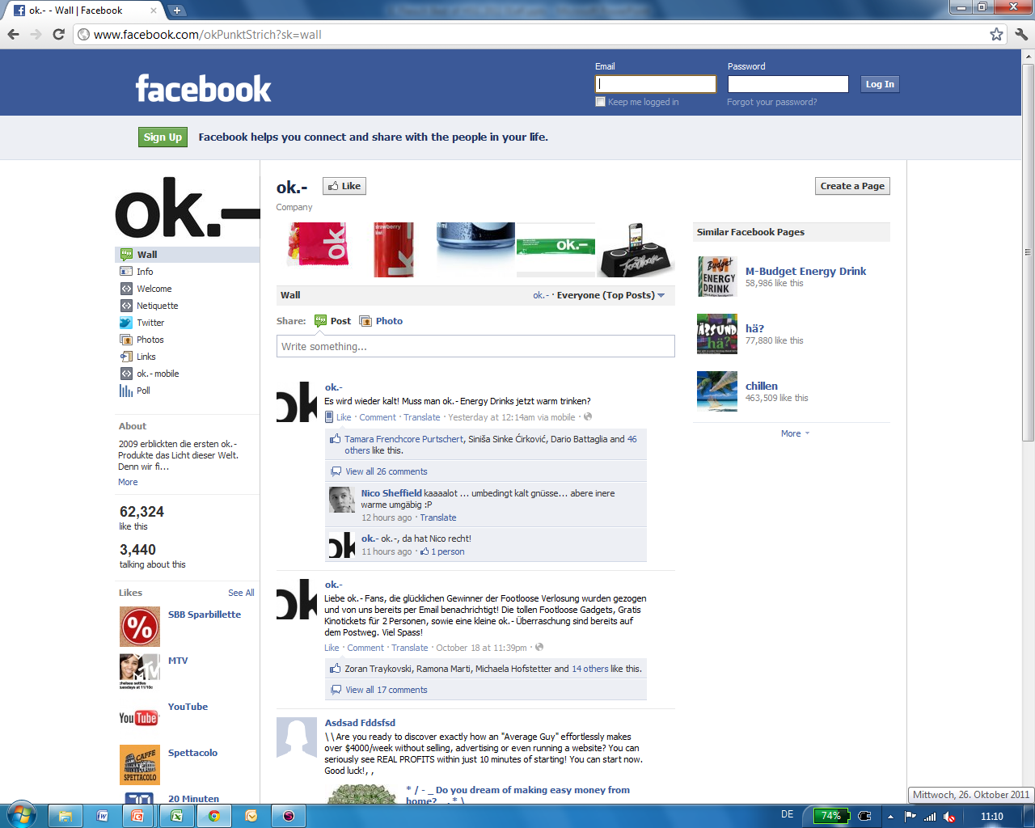

Slide 24
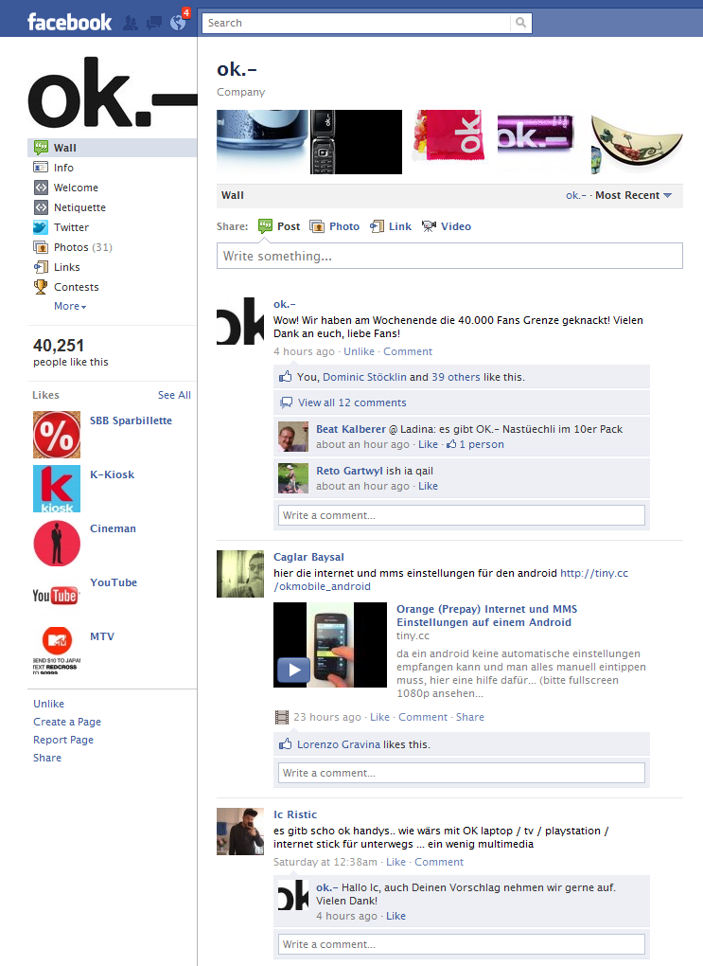

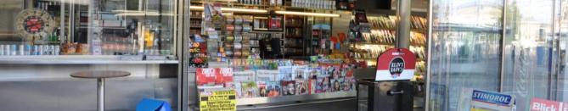
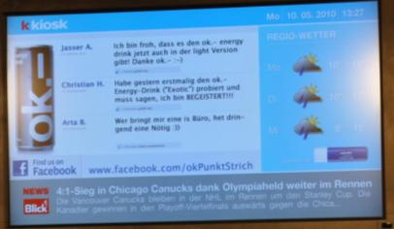
Embedding Social Networks on the Sales Floor
Social Media: Facebook Product Fan Page
Public Display Field Experiment
Facebook comments updated daily
Impact on Sales
Digital signage w/ social network comments increase sales
Product comments are stronger than brand comments
Impact on Customers
text-based messages are harder to read than classical advertising
Digital natives like seeing themselves or friends on screen

Slide 25
Persuasive Computing, Internet of Things, and the Mobile Phone

Slide 26
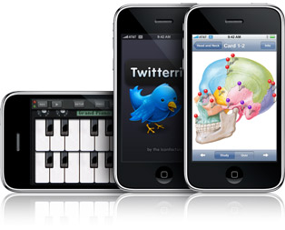

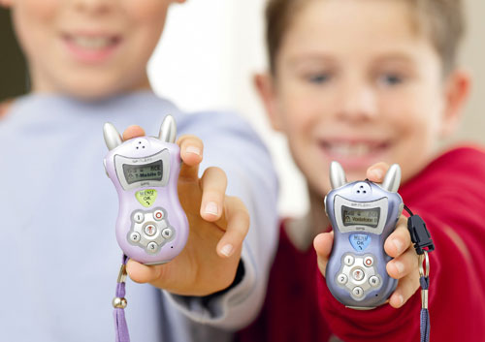
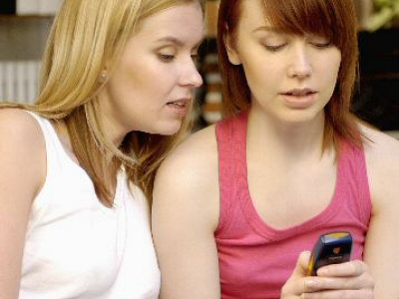
The mobile phone…
1985!
Extended Ego
Harry Potter - Effect
Mind-Changer

Slide 27
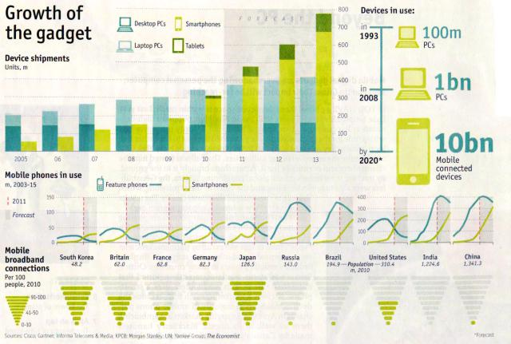
The triumphal procession of the smart phone
Source: Economist October 2011

Slide 28
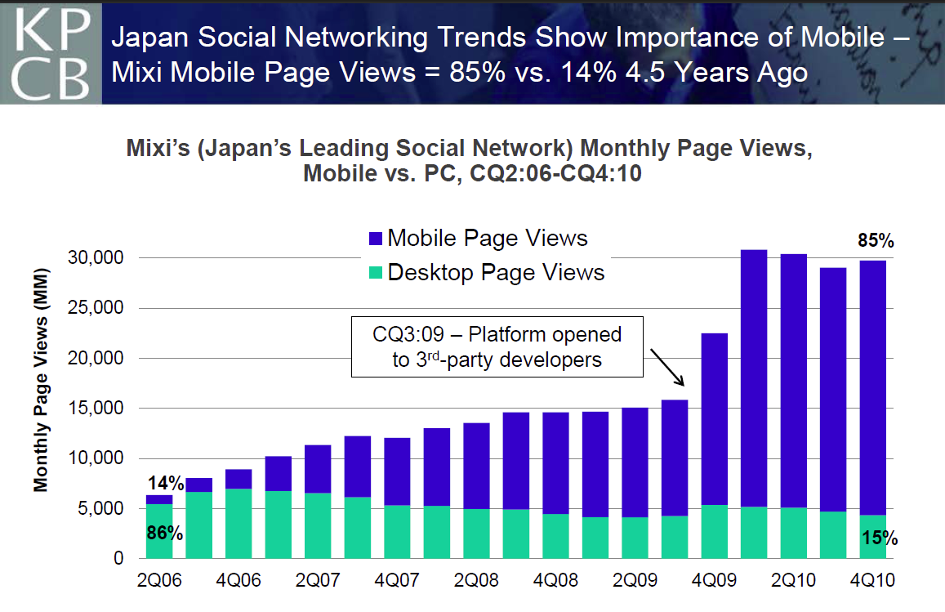
Social goes mobile
Source: KPCM Report on the Mobile Internet 2/2011

Slide 29


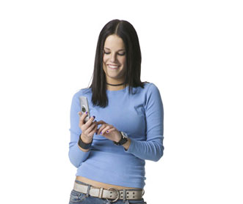

Product information becomes limitless…
Discovery Service
PIM-System
2. ID, IP
3. Product
information
1. ID

Slide 30

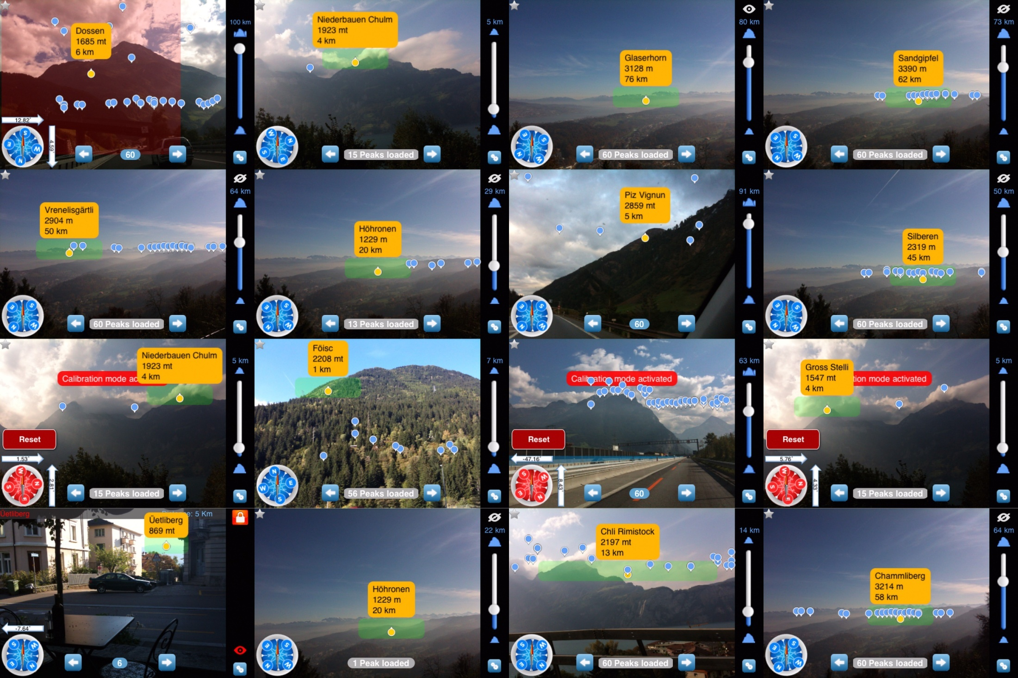
The world through the eyes of my cell phone

Slide 31
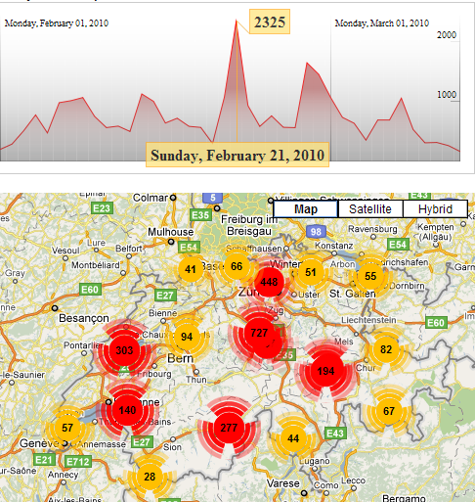
Live Access Statistics for Swiss Peaks

Slide 32
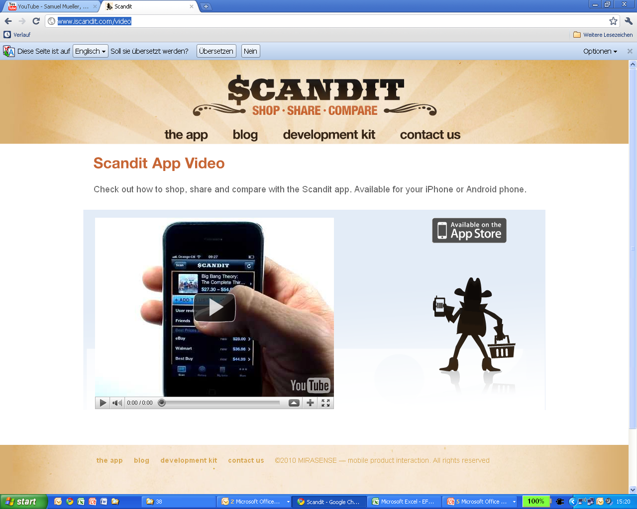
The retail industry already feels it

Slide 33
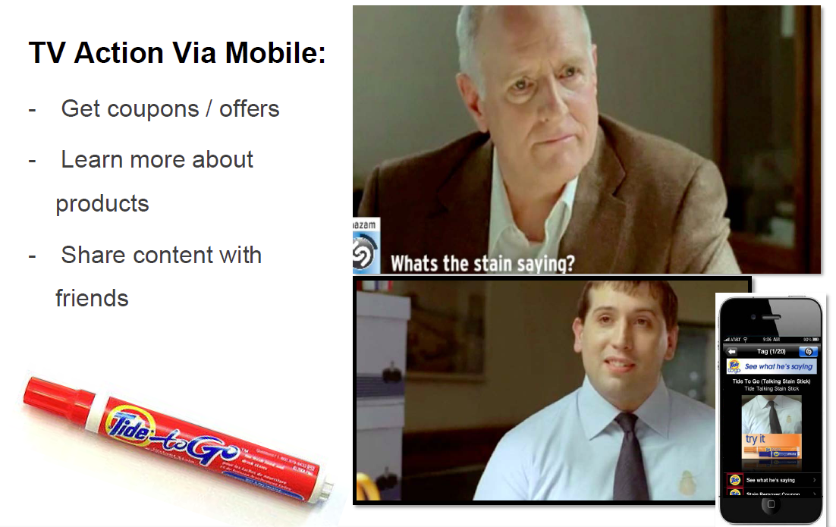
Advertisement volume picks up
Source: KPCM Report on the Mobile Internet 2/2011

Slide 34
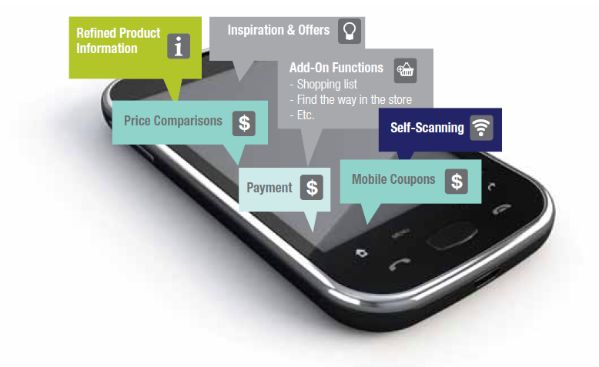
Major Functions of PUSH
Consumer Dashboard – Simple, Fun, Budget Control
Dashboard & digital receipt
MySpending ($, kCal, CO2, km, per category, over time)
Comparison with peers, and friends
Recommendation, sharing, rating
Shopping list
Digital product info
Self scanning
Retailer Cockpit – Boost loyalty, reduce price sensitivity & cost
Direct marketing
Direct feedback / market research
Control consumer spending patterns
Value added services (quality control, financing,…)
Dense brand world
Reduce strategic thread
Payment – Simple, Secure, Fun, Low Budget
From Cash to Push
Mini Bank account (+ multiple virtual membership accounts)
ATM Function
Visual bank note
Freemium model
PSP

Slide 35
So what?

Slide 36






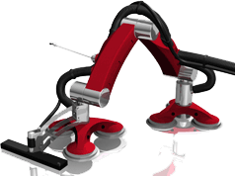

We are still at the beginning
Industrial robotic
  In production environment since 1960
  Today 800.000 robots world wide;
  market 5.6 bio USD with 7% average growth rate
  Growth 2002 -> 2003: 26%
  Cost decline 2002:1990 -> 1:5
Home robotic
  2006 home robotic market > industrial market
  Vacuum cleaner, lawn mower, surveillance, toys

Slide 37
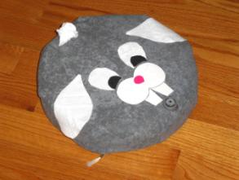
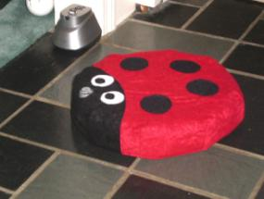
We can anticipate technology, but never applications
Source: myroombud 2009
Source: myroombud 2009
Intimacy of a Roomba owner towards the robot:
  Feeling happiness towards Roomba
  Lifelike associations and engagement with Roombas
  Valuing Roomba: promoting and protecting it
Notes:
Intimacy of Roomba owner towards robot
Many owners feel the need to personalize their robots.
A study showed that out of 30 Roomba owners 21 gave their robot a name. (Sung et al., 2007)
A group of children took advantage of this intimate relationship and founded the company “myRoomBud” in 2005. They came up with the idea of making covers for Roombas. (see pictures).
Three manifestations of this intimacy:
1. Feeling happiness toward Roomba
Vacuuming suddenly became entertaining!
Interestingly, total cleaning time with the Roomba was not reduced since most owners were monitoring the robot at work!
2. Lifelike associations and engagement with Roombas
Most participants of the study regard their Roomba as a household companion with lifelike characteristics
Some even reported that they felt grief when they had to send in their Roomba for repair!
3. Valuing Roomba: promoting and protecting it
Most Roomba owners were so proud and convinced of their robot that they wanted to show and promote it to others (most sales by word of mouth)
Roombarization: interviewed households also reported that they had made changes to their homes to facilitate Roomba’s work

Slide 38
So what?
Do not forecast
We can forecast technology but never its applications
Technology can drive strategy
New technologies regularly lead to new products
The one who has the data has the business
Information follows work and capital as new core asset
Analytics is cool
Big data and high resolution management
Grow by chunking
Train muscles while you go. Learn by trail & error.

